Slide 1
Python environment and package management
By Shahbaz Chaudhary

Slide 2
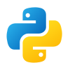

Package managers download and install packages, and their dependencies
Python has two main package managers:
pip (the official package manager)
conda (the one most data scientists use)
This is what you should use

Slide 3
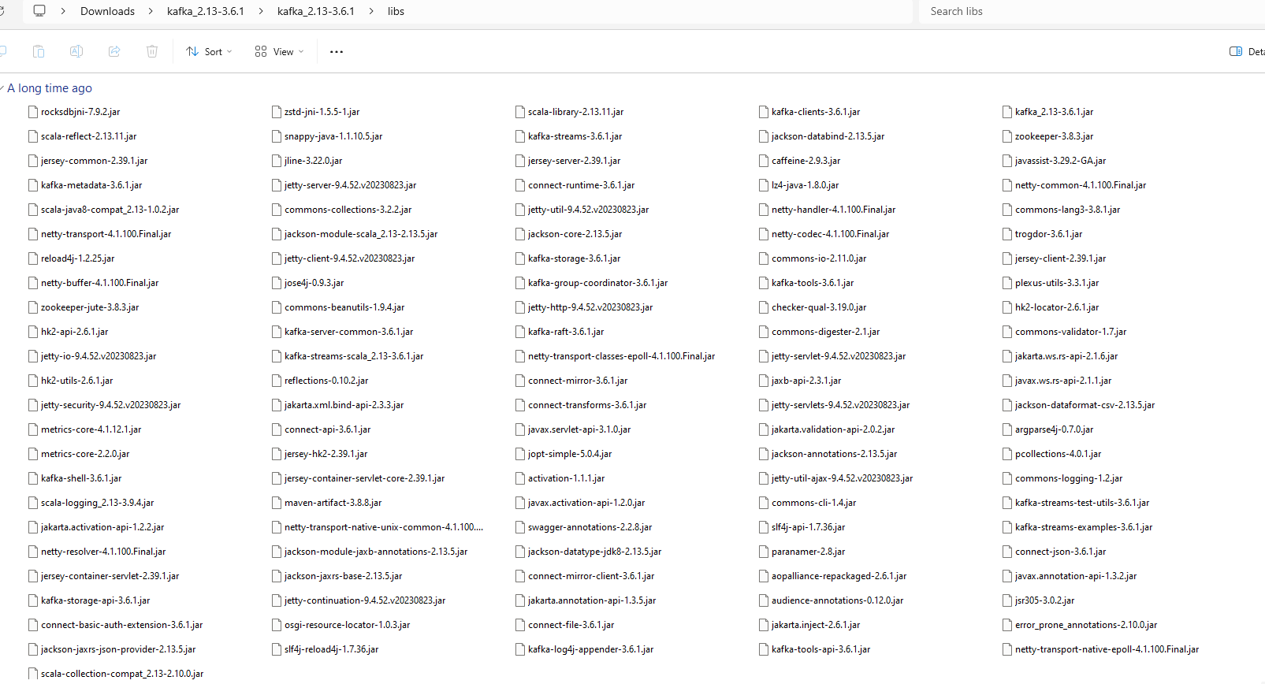
Before package managers Every software came with all dependencies (leading to duplication)

Slide 4
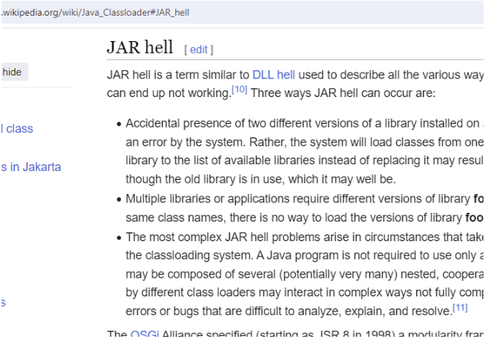
Sometimes there were mismatches with libraries

Slide 5



The world is full of package managers
apt install software
brew install –cask software
chocolatey install software
yum install software

Slide 6
Package managers

Slide 7
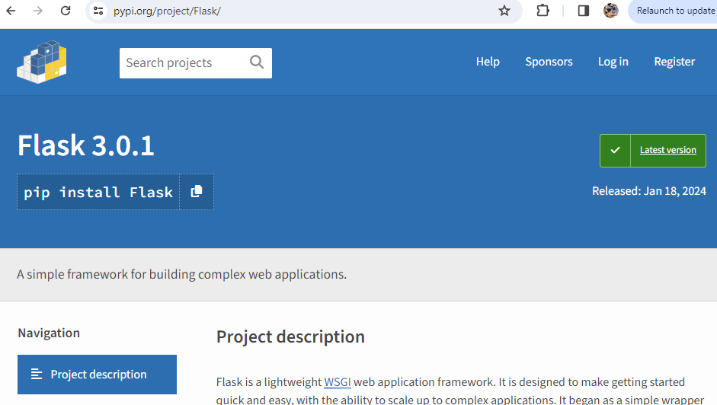
Python’s official package manager is pip And pypi.org is the official repository

Slide 8
Let’s try pip First create an experimental environment (explained later)
Create* new environment to protect your existing system
conda create --name adv_python python=3.10
Activate this environment (aka ‘enter’ it)
conda activate adv_python
Confirm the current env
conda env list
(base) C:\Users\shahb>conda env list
# conda environments:
#
base C:\Users\shahb\anaconda3
adv_python * C:\Users\shahb\anaconda3\envs\adv_python
*Delete this environment, if needed: conda env remove --name adv_python

Slide 9
Try installing a package
List all pip packages installed in this env
pip list
(adv_python) C:\Users\shahb>pip list
Package Version
---------- -------
pip 23.3.1
setuptools 68.2.2
wheel 0.41.2
Install a package
pip install tqdm
Collecting tqdm
Downloading tqdm-4.66.1-py3-none-any.whl.metadata (57 kB)
━━━━━━━━━━━━━━━━━━━━━━━━━━━━━━━━━━━━━━━━ 57.6/57.6 kB 607.3 kB/s eta 0:00:00
Requirement already satisfied: colorama in c:\users\shahb\anaconda3\envs\adv_python\lib\site-packages (from tqdm) (0.4.6)
Downloading tqdm-4.66.1-py3-none-any.whl (78 kB)
━━━━━━━━━━━━━━━━━━━━━━━━━━━━━━━━━━━━━━━━ 78.3/78.3 kB 2.2 MB/s eta 0:00:00
Installing collected packages: tqdm
Successfully installed tqdm-4.66.1
(adv_python) C:\Users\shahb>pip list
Package Version
---------- -------
colorama 0.4.6
pip 23.3.1
setuptools 68.2.2
tqdm 0.41.2
wheel 0.41.2
Check again
pip list

Slide 10
Packages are only downloaded once
I recreated the environment and re-installed the package
conda create --name adv_python python=3.10
conda activate adv_python
pip install tqdm
Collecting tqdm
Using cached tqdm-4.66.1-py3-none-any.whl.metadata (57 kB)
Collecting colorama (from tqdm)
Using cached colorama-0.4.6-py2.py3-none-any.whl (25 kB)
Using cached tqdm-4.66.1-py3-none-any.whl (78 kB)
Installing collected packages: colorama, tqdm
Successfully installed colorama-0.4.6 tqdm-4.66.1
New install
Collecting tqdm
Downloading tqdm-4.66.1-py3-none-any.whl.metadata (57 kB)
━━━━━━━━━━━━━━━━━━━━━━━━━━━━━━━━━━━━━━━━ 57.6/57.6 kB 607.3 kB/s eta 0:00:00
Requirement already satisfied: colorama in c:\users\shahb\anaconda3\envs\adv_python\lib\site-packages (from tqdm) (0.4.6)
Downloading tqdm-4.66.1-py3-none-any.whl (78 kB)
━━━━━━━━━━━━━━━━━━━━━━━━━━━━━━━━━━━━━━━━ 78.3/78.3 kB 2.2 MB/s eta 0:00:00
Installing collected packages: tqdm
Successfully installed tqdm-4.66.1
Old install

Slide 11
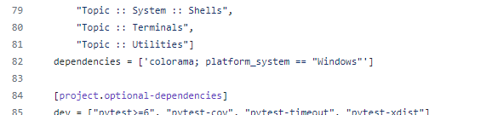
Why is colorama installed?
Because tqdm lists colorama as a dependency in
https://github.com/tqdm/tqdm/blob/master/pyproject.toml

Slide 12
Definition
pip downloads, caches and installs python packages and their dependencies Caveats
For many years, pip was not able to install packages with binary dependencies, such as numpy
pip also doesn’t do a thorough job of making sure all packages and their dependencies will work well together
Great resource: https://jakevdp.github.io/blog/2016/08/25/conda-myths-and-misconceptions/

Slide 13
conda is (currently) the premier package (and environment) manager for data scientists
Unlike pip, it can install packages of any language. In that sense, it is closer to apt/brew/chocolatey.
It can manage non-python dependencies, such as numpy’s c based libraries (although pip can also do this now)
It has a very powerful solver. When you install packages
conda install package_a package_b package_c
It will make sure all three packages can work with existing libraries in the environment, they can work with each other and all dependencies can work with all other dependencies! You are less likely to have version mismatch issues.
Caveats
Sometimes dependency resolution can result in extremely (unbearably) long wait times to install packages. So much so that a new project has started up: mamba (https://github.com/mamba-org/mamba). As of late 2023, some features of mamba have been included in conda.

Slide 14
Modern conda and pip work well together
pip install tqdm
conda install flask
(adv_python2) C:\Users\shahb>python
Python 3.12.1 | packaged by Anaconda, Inc. | (main, Jan 19 2024, 15:44:08) [MSC v.1916 64 bit (AMD64)] on win32
Type "help", "copyright", "credits" or "license" for more information.
>>> import tqdm, flask
>>> tqdm.__file__
'C:\\Users\\shahb\\anaconda3\\envs\\adv_python2\\Lib\\site-packages\\tqdm\\__init__.py'
>>> flask.__file__
'C:\\Users\\shahb\\anaconda3\\envs\\adv_python2\\Lib\\site-packages\\flask\\__init__.py'

Slide 15
Modern conda and pip work well together
adv_python.yml
name: adv_python
channels:
- conda-forge
dependencies:
- python
- pandas
- numpy
- pip
- pip:
- pytorch
- flask
Generate an environment yaml file
conda env export > adv_python.yml
Create an environment based on the yaml file
conda env create -f adv_python.yml

Slide 16
Appendix
Some icons from https://icons8.com/

